Slide 1
The Modern
Open Source Programs Office
@jeffmcaffer, GitHub
Notes:
I’m Jeff McAffer, a product manager at GitHub focusing on open source at scale.
Until recently I was the Director of the Microsoft Open Source Programs Office
Helping teams at Microsoft to get really good at engaging with open source
Then I moved to GitHub to bring over some of the Microsoft experience and make it available to everyone

Slide 2

Notes:
And until recently I was the Director of the Microsoft Open Source Programs Office
The set of folks tasked with helping Microsoft “get good” at open source
My move to GitHub was really to take what I learned at Microsoft and try to help everyone have a great open source program
Today I’ll share some of those ideas and approaches with you

Slide 3



Your logo here
Notes:
Now, this story is not unique to Microsoft. Many have gone before and many will come after
And you don’t have to be Microsoft scale to have these challenges.
Anything over 100 is hard to manage manually and “one off”.

Slide 4
Aspiring to world-class isn’t enough when everyone else starts there.
Notes:
It all starts with a basic premise. Aspiring…
This is doubly true in a DevOps world where you’re all about the rapid and reliable delivery of capability
That happens, at least in part, by acquireing and assembling components from all around you to deliver solutions

Slide 5

Notes:
Back in the day (e.g. ,5 or 6 years ago) we were doing open source but not a lot

Slide 6

Notes:
Pan forward and now there are 32K Microsoft folks on GitHub

Slide 7

Notes:
And lots of projects both being released and used by the teams

Slide 8

Notes:
That doesn’t happen with some organization
When you’re running fast you don’t have time to stop and figure out what’s up with some new component your using
We had to build some pretty serious infrastructure to ensure everything was
Automated
Discoverable
Categorized
And that we had data for content warnings, vulnerabilities, compliance info

Slide 9


Trojan
unicorn?
Notes:
Cause, you know, open source is not without its surprises. Every once in a while, there’s a trojan unicorn in the mix
Tip o the hat to Gene Kim and The Unicorn Project

Slide 10
Culture eats process and tools
-- Peter Drucker (paraphrased)
Notes:
Ok so many of us are devs to we naturally think “there’s an app for that”. Right?
Well, in many cases there is!
But no matter how much you organize and tool, if people are scared, don’t understand, or are not motivated, it just isn’t gonna happen

Slide 11

Notes:
Having a few individuals off in a corner trying to figure things out is not going to unlock the power of open for your organization

Slide 12

Notes:
Building a culture with lots of hands helping and sharing, now that’s where the magic happens.

Slide 13

Notes:
We had to build well paved and maintained community paths
Where people know that collaborating is expected, desired, and safe
We had to generate a clear understanding of the cultural and technology norms around open source and collaboration

Slide 14
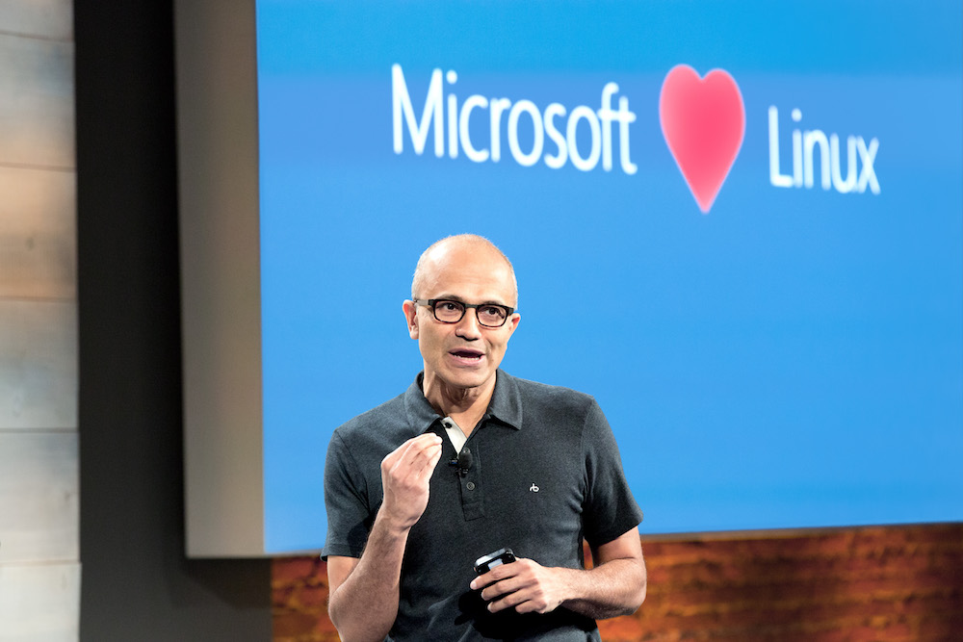
Notes:
Fortunately, lots of guidance was coming from top down

Slide 15
There’s no free lunch
-- Anyone who’s done, well, anything really
Notes:
But there’s no free lunch
Someone’s got to drive this or its not going to happen

Slide 16
Open Source Programs Office
Notes:
Enter the open source programs office
2015 was really a pivotal time. There had been lots of point efforts around open source but that was the year of going broad
“all in” to use Microsoft speak of the time
To scale our engagement and make it pervasive was going to take a sustained, coordinated effort.
And so the Microsoft OSPO was created

Slide 17
Culture
Initiatives
Policies
Processes
Tools
Engineering
Business
Notes:
Sits at the nexus of culture, business and engineering
Drives initiatives, sets policies, creates processes and tools to support the initiatives and policies
That smooth the path for engaging in open source

Slide 18
Legal
HR
Security
Accessibility
Engineers
OSPO
Exec guidance
Industry peers
Communities
Collaborators
Customers
Notes:
Orgnaization nexus:
Also sits at an organizational nexus.
Put it where you want but close to engineering:
You can put it where you want (see it all over the place) and to a certain degree it depends on where you are in your progression to open source enlightenment
In the end open source is all about collaborating on code and that’s an engineering function
Partner partner partner
Microsoft’s OSPO is in the central engineering systems team for the company. That’s a great spot for it

Slide 19
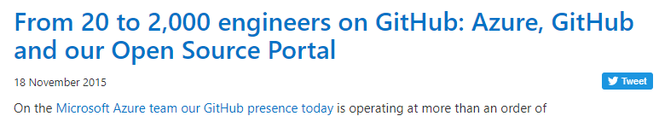
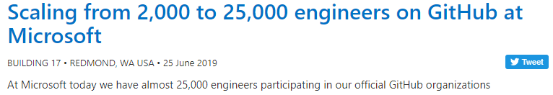


https://jeff.wilcox.name
Notes:
Jeff Wilcox, one of the folks on the team, wrote a couple blog posts over the years documenting some of the tools and processes we put in place
Really great reads to get a sense of the depth and breadth of the challenges

Slide 20

10M uses
100 orgs
10K products
32,000 users
200K versions
7,000 teams
50K components
22,000 repos
+500K/m uses
Notes:
And if we look at the program simply by the numbers, it’s pretty astonishing

Slide 21
How’d we do it?
Notes:
OK so you’re sitting there thinking “holy crap Jeff, how’d y’all do that?”. Well, lemme tell ya…
10 people directly on the team + 20 or so SMEs and tooling partners
Worked for ~3 years to get proficient

Slide 22
culture & process
Notes:
Evolve culture and process together
Earlier I said that culture eats process and tools but really they have to evolve together.
Thought evangelize open soruce but policy/process were not ready
For example we started out with the idea that we’d need to evangelize open source and get people engaged
Turns out it wasn’t a hard sell but the policies and process were too hard and they didn’t believe us.
20 questions
For example, when we first started a dev had to manually answer 20 skill testing questions for every use of open source
We had to fix that to enable the culture change we wanted

Slide 23

consulting
data
playbooks
insights
meetups
confidence
sponsor
Notes:
Help build understanding, community and culture
Every month we’d have some team show up saying they wanted to open source some key piece of tech or product
I love open source but I also love getting paid so we’d walk through the 5 whys and really try to understand the business, what they’re hoping to achieve
And in the end devise a plan
Provide data and insights to measure progress
Get involved in the

Slide 24
Eliminate
Delegate
Identify
Automate
iterate
continuously
Notes:
We adopted this Mantra: identify, eliminate, automate, delegate
99.5% automation
Got it to the point where 99.5% of all new open source uses are managed automatically
Still 2500 reviews per month but …
Continuously iterate (every month)
Every month or so we’d find ways to eliminate more friction or automate something as we got a better understanding of the business, the risks, or how teams worked

Slide 25
Managing open source use
Registration
Product-based
History/retention
Notification
Alerts/email
CI/CD breaks
Detection
Binary/Package
Loose files
Remediation
Automated PRs
Ongoing
Freshness
Vulnerabilities
Insights
Dashboards
Reporting
Discover/Assess
VS Code
Browser
Policy
Security
Compliance
Health
Compliance
Notices
Source disclosure
Ingestion
Source escrow
Package mirroring
Static analysis

Slide 26

CLA Assistant
Contribution management
GitHub Portal
Self-service GitHub management
repolinter
Repo consistency @ scale
GHcrawler
Monitor your GitHub presence
ClearlyDefined
Crowd-source compliance data
GHTorrent
Software engineering insights
Notes:
Over the course automating everything we created and collaborated on quite a few open source efforts
GitHub Portal
Automation needs data!
Garbage in, garbage out
* Ghcrawler
* ClearlyDefined

Slide 27
Creating your own
Notes:
That was a lot of detail on what we did
There are many variations and your situation may be different
But the core elements are the same
Here is the context I wish we had when we started

Slide 28



What’s your value?
Notes:
First figure out what’s special about you? Really understand your business.
This will help set the scene and make many of the discussions and decisions easier
Why do people buy your offerings
Why do they celebrate or anticipate new releases
Why do they rave about you
THEN you can start talking about how to engage significantly in open source

Slide 29

What’s your current engagement level?
https://mcaffer.com/2019/02/Open-source-engagement
Notes:
Last year I put together a “engagement model” that charts different stages of open source engagement
Everyone’s different and different goals and not everything may apply to you but the very act of figuring out where you on are these different aspects is useful
And you can then use it to plot and prioritize your next steps.
I’m going to skim over them here partially to give you a sense of the model and partially to cause I had a lot of fun finding lego pictures to capture each level ☺
Check out my blog post for details.

Slide 30

Denial
Prevention
Countering
Attacking
Notes:
Darth’ll get you for doing open source
We were here

Slide 31

Hype
Silver bullet
Marketing
Recruit/retain
Incoherent
Notes:
Open source is all about people, community and engagement
Ultimately this level is not sustainable as a part of the business model so will not be genuine
Very likely to lead to disappointment for all parties
We were here

Slide 32

Tolerant
Limited
Experimental
Ad hoc
Fearful
Not rewarded
Notes:
Couple folks hiding under the space bar drinking cool coffee and doing crazy things.
Not much more to say really
I’m betting a lot of you all are at this stage
We were here

Slide 33

Proficient
Systematic
Tooled
Broad
Engaging
Efficient
Notes:
We are here (for the most part)
Vast majority

Slide 34

Fluent
Value
Fundamental
Rationalized
Open
Rewarded
Notes:
Have a few teams that are here
VS Code
DotNet et al
Etc.

Slide 35

Mastery
Integral
Liberating
Disruption
Shared control
Proactive
Notes:
Not many if any teams at this level

Slide 36
Where do you want to be?

Slide 37
How are you
going to get there?
Notes:
What steps can/ will you take to get to next level?

Slide 38

https://todogroup.org
Notes:
Lots of information on how OSPOs work, how to start one, case studies, …

Slide 39
Hopefully this helps

